Slide 1
The Perception of Power in Consumer-Brand Relationships
Elder Semprebon
Paulo H. M. Prado

Slide 2
The Perception of Power in Consumer-Brand Relationships
Strong Brands
Self
But what happens
after that?
Self Identification
Social Identification
Attachment Process
…
Or Strong Brand Equity

Slide 3
The Perception of Power in Consumer-Brand Relationships
Power
Routinely, consumers have experiences of feeling powerful or powerless, according to the assumed roles (Rucker; Galinsky, 2008).
Power is part of any relationship, because it determines how partners relate each other and how decisions are made (Dunbar, 2000).

Slide 4
The Perception of Power in Consumer-Brand Relationships
Brand power => the ability of a brand in influencing consumer behavior and lead a consumer to do something they otherwise would not do (Crosno; Freling; Skinner, 2009).
Personal sense of power => the ability to control resources, own or others, without social interference (Galinsky, Gruenfeld; Magee, 2003).

Slide 5
The Perception of Power in Consumer-Brand Relationships
And considering that:
All social relationships is fundamentally dyadic and asymmetric (Rollins; Bahr, 1976; Keltner, et al, 2008).
The power imbalance is inevitable in relationships.
There will always be a dominant part (high power), and other compliant (low power), that is, relationships are asymmetric according to the concentration of power.
H1: The consumer power will be lower (vs. higher) in dealing with high (vs. low) brand power.

Slide 6
The Perception of Power in Consumer-Brand Relationships
Study 1
Single factor between-subjects - n = 180 students
55% males, av. age 22
Paper and pencil application
Scenario for low power Brand (lpb): You just bought a tennis shoes from XYZ. This brand is not considered famous at the market. Generally people who own this brand do not talk to their friends anything special about it. But this brand is considered a high quality brand.
Scenario for high power brand (hpb): You just bought a tennis shoes from XYZ. This is a famous brand at the market. The brand is considered wit high quality and offers interesting benefits. So there are a lot of consumers that are attracted by XYZ. You have heard some friends talking positively about this brand.

Slide 7
The Perception of Power in Consumer-Brand Relationships
Study 1 (H1)
No significant difference on Importance of the tennis shoes, scenario realism, involvement
HPB has Higher perception of power (5,98) than LBP (5,09) (t=3,41, p<0,01)
Consumer Perception of Power are higher for LPB (7,28) than for LBP (6,89) (t=2,43, p=0,015)

Slide 8
The Perception of Power in Consumer-Brand Relationships
Study 2
Single factor Between-subjects - n = 60 street runners
72% males, av. age 29
Qualtrics Application with subjects selected from a pull of regular runners
Scenario: Imagine this situation:
Next Sunday you will participate at a street run meeting. Your main goal is to get a good result. You want the lower your time, improve your limits and, maybe, be at the top 25 runners. You will run with a RAINHA (ASICS) tennis shoe. The Upper part is a Spacer mesh, TPU welds, synthetic leather. The Midsole is composed by Tri-density EVA foam with heel and forefoot Gel pads. Firmer foam insert on inner side. Midfoot is a plastic shank, 10mm heel drop. And the Outsole is a composite from Heel carbon rubber wit a blown forefoot rubber

Slide 9
The Perception of Power in Consumer-Brand Relationships
Dependence is one reason for asymmetric power in relationships (Molm; Cook, 1995).
The power resides implicitly on the dependence of other (Emerson, 1962). The dependence of a subject is a potential source of power to another. The power imbalance may be defined by the difference in power caused by dependence (Molm, 1991).
H2: The indirect effect of brand power through dependence on consumer power will be negative.

Slide 10
The Perception of Power in Consumer-Brand Relationships
Study 2 (H1)
No significant difference considering Involvement, scenario understanding and realism.
ASICS has higher perception of power (7,61) than RAINHA (3,51) (t=9,70, p<0,01)
Consumer Perception of Power are higher for RAINHA (7,52) than for ASICS (6,95) (t=2,47, p=0,016)

Slide 11
The Perception of Power in Consumer-Brand Relationships
Study 2 (H2)
Influence of Brand on Dependence
Consumer Perception of Dependence are lower for RAINHA (2,79) than for ASICS (6,48) (t=6,29, p<0,001)

Slide 12
The Perception of Power in Consumer-Brand Relationships
Study 2 (H2)
Brand dependence
-0,0991
p<0,05
3,68
p<0,01
H2
Brand Power
Consumer
Power
-0,22 ns

Slide 13
The Perception of Power in Consumer-Brand Relationships
Trust should not be a mechanism of control but a substitute for control. The control comes from low trust (Rousseau; Sitkin; Burt; Camerer, 1998).
Trust has a moderating role in the dependency relationship between two parties.
When there is low trust and high dependence, the intention of cooperation is low, thereby increasing the asymmetry between the parts (Andaleeb, 1995).
H3: When there is low trust, the negative indirect effect (by dependence) of the brand power over consumer power will be significantly negative.

Slide 14
The Perception of Power in Consumer-Brand Relationships
Study 3
2 (brand power: low x high) x 2 (trust: low x high) - Between-subjects
n = 133 students; 56% females, av. age 23
Low brand power: CCE / High brand power: Sony
Paper and pencil application
Scenario: Brand Manipulation
You are at a critical time at your life, end of the semester at your undergrad, and you nee to finish important jobs (end of course essays, credit homework and final presentations). You just bought one notebook from CCE (Sony) wit the following configuration: 15’’ screen, processor with 2.90 GHz, 4 Gb RAM and 500 Gb HD. This notebook is very important do allow you to finish all your tasks and maintain your schedule under control.

Slide 15
The Perception of Power in Consumer-Brand Relationships
Study 3
Manipulation of Brand trust
Scenario: (Negative)
A few days after you bought your new SONY/CCE notebook, it has some serious problems. It starts to heat the processor for no apparent reason. So it stops working. You don´t know by now if you will access your files. You contacted the Costumer Service and they informed you that there are some factory problems and that the brand will substitute your computer in 45 days. At the internet you found a lot of complaints about the brand...

Slide 16
The Perception of Power in Consumer-Brand Relationships
Study 3 (H1)
No significant difference considering Involvement, scenario understanding and realism.
SONY has higher perception of power (5,53) than CCE (2,37) (t=15,84, p<0,01)
Consumer Perception of Power are higher for CCE (7,05) than for SONY (6,12) (t=4,93, p<0,01)

Slide 17
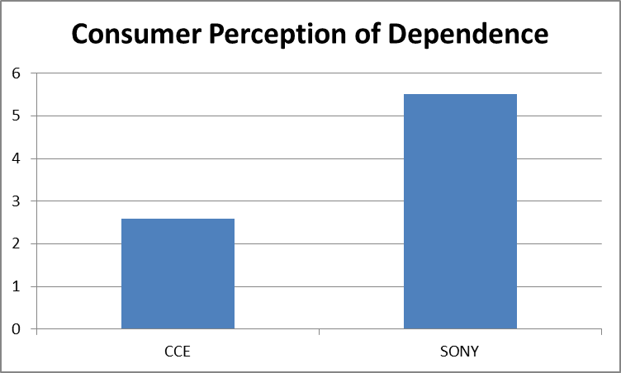
The Perception of Power in Consumer-Brand Relationships
Study 3 (H2)
Influence of Brand on Dependence
Consumer Perception of Dependence are lower for CCE (2,48) than for SONY (5,51) (t=13,06, p<0,001)

Slide 18
The Perception of Power in Consumer-Brand Relationships
Study 3 (H2)
Brand dependence
-0,15
p<0,05
3,03
p<0,01
H2
Brand Power
Consumer
Power
-0,43 ns

Slide 19
The Perception of Power in Consumer-Brand Relationships
Study 3 (H2)
Consumer Perception of Power
Checking Trust Manipulation:
High Trust Scenario (6,09)
Low Trust Scenario (5,15)
(t=2,03; p=0,05)
Main effect of Brand Power
(F= 25,68; p<0,01)
Main effect of Brand Trust
(F=4,12; p=0,044)
Interaction Brand Power x Brand Trust (F=5,21; p=0,028)

Slide 20
The Perception of Power in Consumer-Brand Relationships
Brand trust
Brand dependence
(-)
(+)
H3
H2 (-)
Brand Power
Consumer
Power
H1 (-)

Slide 21
The Perception of Power in Consumer-Brand Relationships
Study 3 (H3)
Brand Trust
Brand dependence
H3
Brand Power
H2
Consumer
Power
H1
R²=0,2194 (Sig=0,00)
 |  | Effect | SE | LLCI | ULCI
Indirect effect | Low trust High trust | -0,6456 -0,2388 | 0,2803 0,2684 | -1,2160 -0,7659 | -0,1162 0,2910

Slide 22
The Perception of Power in Consumer-Brand Relationships
Brand trust
Brand dependence
(-)
(+)
H3 (Valid for low trust)
H2 (-)
Brand Power
Consumer
Power
H1 (-)

Slide 23
The Perception of Power in Consumer-Brand Relationships
In summary, the findings of this study were
the reduction of consumer power perceived in dealing with high brand power (H1),
this asymmetry of power comes from the brand dependence in a specific situation (H2),
occurring the effect is more intense when there is low brand trust (H3).

Slide 24
The Perception of Power in Consumer-Brand Relationships
Some opportunities:
Studying the role of trust at the model:
Long term relationship (not just a negative event)
Studying the power transfer process:
The impact on achieving results
The impact on decision
Studying the impact of brand characteristics
Attach the core x the periphery
Dimensions associated to Personality

Slide 26
Social Brand Power (CROSNO; FRELING; SKINNER, 2009)
Perception of Consumer Power (ANDERSON; JOHN; KELTNER, 2012)

Slide 27
Brand Trust (Francisco-Maffezzolli, 2013)
Dependence (adapted from MOLM; COOK, 1995).

